Slide 1
Mark 6 : 30-56

Slide 2
³⁰ The apostles returned to Jesus and told him all that they had done and taught. ³¹ And he said to them, “Come away by yourselves to a desolate place and rest a while.” For many were coming and going, and they had no leisure even to eat. ³² And they went away in the boat to a desolate place by themselves. ³³ Now many saw them going and recognised them, and they ran there on foot from all the towns and got there ahead of them. ³⁴ When he went ashore he saw a great crowd, and he had compassion on them, because they were like sheep without a shepherd. And he began to teach them many things. ³⁵ And when it grew late, his disciples came to him and said, “This is a desolate place, and the hour is now late.

Slide 3
³⁶ Send them away to go into the surrounding countryside and villages and buy themselves something to eat.” ³⁷ But he answered them, “You give them something to eat.” And they said to him, “Shall we go and buy two hundred denarii worth of bread and give it to them to eat?” ³⁸ And he said to them, “How many loaves do you have? Go and see.” And when they had found out, they said, “Five, and two fish.” ³⁹ Then he commanded them all to sit down in groups on the green grass. ⁴⁰ So they sat down in groups, by hundreds and by fifties. ⁴¹ And taking the five loaves and the two fish, he looked up to heaven and said a blessing and broke the loaves and gave them to the disciples to set before the people. And he divided the two fish among them all.

Slide 4
⁴² And they all ate and were satisfied. ⁴³ And they took up twelve baskets full of broken pieces and of the fish. ⁴⁴ And those who ate the loaves were five thousand men.
⁴⁵ Immediately he made his disciples get into the boat and go before him to the other side, to Bethsaida, while he dismissed the crowd. ⁴⁶ And after he had taken leave of them, he went up on the mountain to pray. ⁴⁷ And when evening came, the boat was out on the sea, and he was alone on the land. ⁴⁸ And he saw that they were making headway painfully, for the wind was against them.

Slide 5
And about the fourth watch of the night he came to them, walking on the sea. He meant to pass by them, ⁴⁹ but when they saw him walking on the sea they thought it was a ghost, and cried out, ⁵⁰ for they all saw him and were terrified. But immediately he spoke to them and said, “Take heart; it is I. Do not be afraid.” ⁵¹ And he got into the boat with them, and the wind ceased. And they were utterly astounded, ⁵² for they did not understand about the loaves, but their hearts were hardened.

Slide 6
⁵³ When they had crossed over, they came to land at Gennesaret and moored to the shore. ⁵⁴ And when they got out of the boat, the people immediately recognised him ⁵⁵ and ran about the whole region and began to bring the sick people on their beds to wherever they heard he was. ⁵⁶ And wherever he came, in villages, cities, or countryside, they laid the sick in the marketplaces and implored him that they might touch even the fringe of his garment. And as many as touched it were made well.

Slide 7
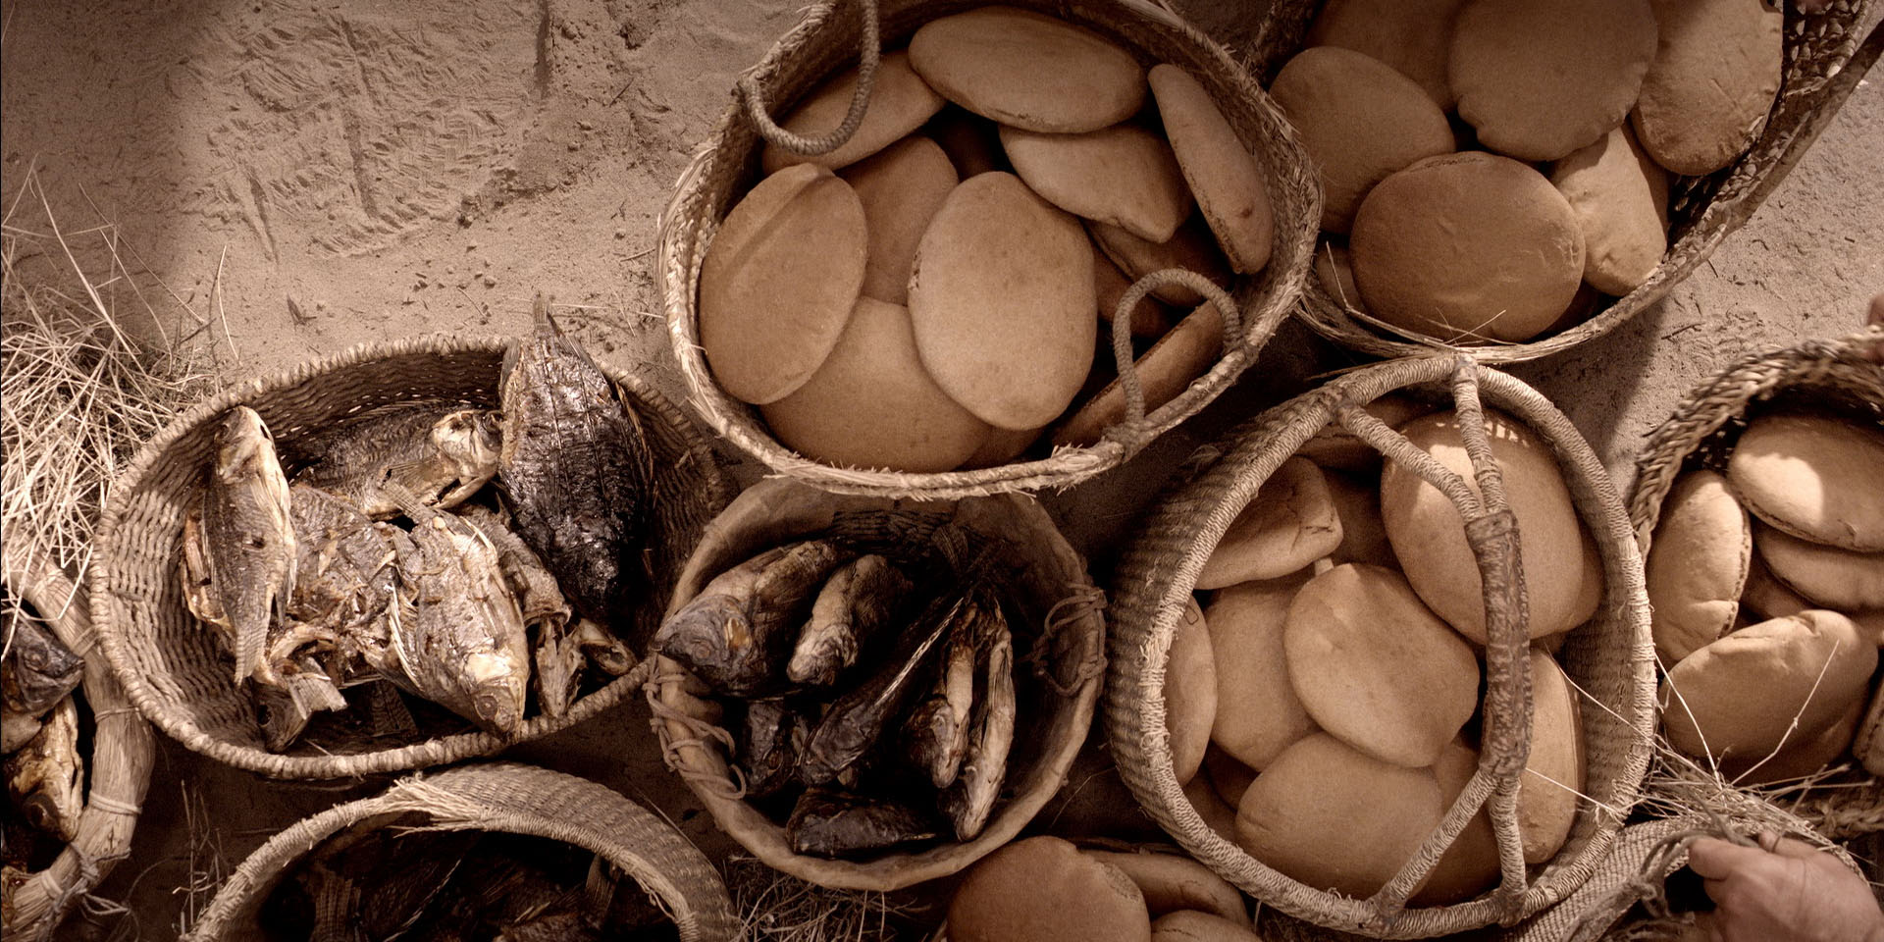

Slide 8
Jesus Feeds 5000 & Walks on Water
1. We give what we have. God takes care of the Rest
2. Jesus is ‘The Christ’, the Son of God...
God miraculously fed bread to the people of Israel out in the wilderness.
This is something that only God can do.
$${(5 loaves+2 fish)}^{Jesus} − \left(appetite of a man × 5000\right)=12 Baskets of Leftovers$$
Jesus walks on water. The disciples are terrified.
“Take heart; it is I. Do not be afraid.”
they were utterly astounded, ⁵² for they did not understand about the loaves, but their hearts were hardened.
Jesus fed bread to the people in the wilderness. Only God can do this
God tells Moses His Name, Ἐγώ εἰμι (Ego Eimi) “I am”
Jesus identifies Himself, “Take heart Ἐγώ εἰμι (Ego Eimi) “I am”
Jesus identifies Himself as God
“Hardness of heart” is the failure to recognise the divinity of Jesus (He is God)
Jesus claims to be God. Is He a Liar? Is He a Lunatic? Or is it true? Is He Lord?
Not just “a life improver”. He is God.
He owes us nothing. We owe Him everything.
We owe Him our worship, simply because He is God

Slide 9
^{Mark 14:22} … as they were eating, he took bread, and after blessing it broke it and gave it to them, and said, “Take; this is my body.” ²³ And he took a cup, and when he had given thanks he gave it to them, and they all drank of it. ²⁴ And he said to them, “This is my blood of the covenant, which is poured out for many.

Slide 10
1. We give what we have. God takes care of the Rest
2. Jesus is ‘The Christ’, the Son of God (Jesus is God who deserves our Worship)
God miraculously fed bread to the people of Israel out in the wilderness.
This is something that only God can do.
$${(5 loaves+2 fish)}^{Jesus} − \left(appetite of a man × 5000\right)=12 Baskets of Leftovers$$
Jesus fed bread to the people in the wilderness. Only God can do this
Jesus walks on water. The disciples are terrified.
God tells Moses His Name, Ἐγώ εἰμι (Ego Eimi) “I am”
Jesus identifies Himself, “Take heart Ἐγώ εἰμι (Ego Eimi) “I am”
Jesus identifies Himself as God
“Hardness of heart” is the failure to recognise the divinity of Jesus (He is God)
Jesus claims to be God. Is He a Liar? Is He a Lunatic? Or is it true? Is He Lord?
Not just “a life improver”. He is God.
He owes us nothing. We owe Him everything.
We owe Him our worship, simply because He is God
3. Jesus’ Body was broken, to save the many
More than enough for the multitudes to be set free from sin (Forgiven. Justified)
All who repent of sin; seek forgiveness; and give themselves to Jesus, are saved

